Slide 1
Cryptography
An introduction to classical and modern cryptography
Siddarth Senthilkumar
09/??/16

Slide 2
Overview
Cryptosystems we’ll cover today:
One Time Pad (OTP)
Block Ciphers (ECB and CBC)
DES/AES
Stream Ciphers
Diffie Hellman Key Exchange
RSA
<<Any other 3 letter acronyms>>

Slide 3
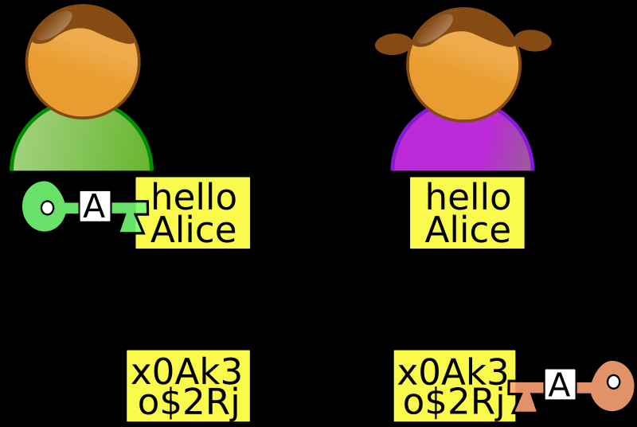

What is cryptography
BOB
ALICE
- How to send information securely from one party to another securely
- It should be Hard to crack the original message without the key.
Plaintext
Insecure
Ciphertext
Eve
Notes:
If you look carefully I wrote securely twice because that’s important – varying definitions securely:
Integrity, confidentiality, authentication (know who sent msg)
- What do we mean by hard?

Slide 4
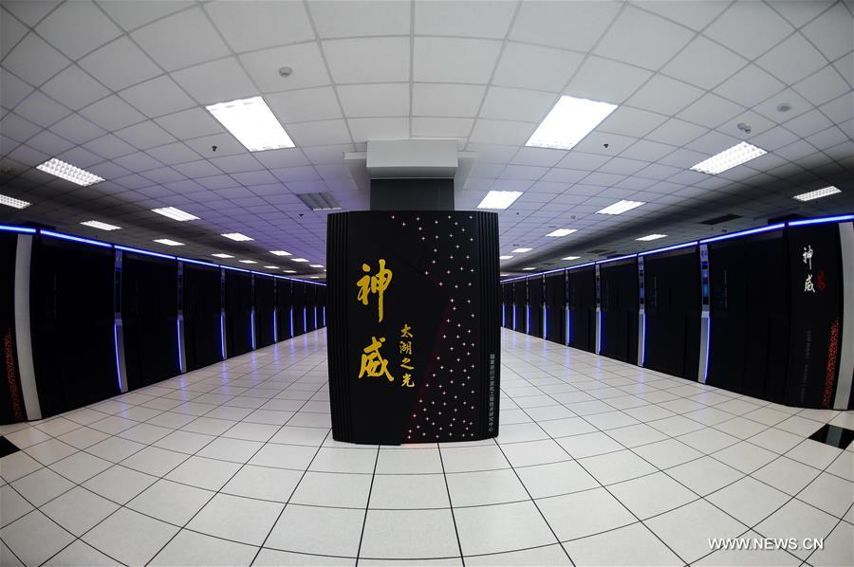
Notes:
National Supercomputing Center - Wuxi China
Our computers – 2-4 cores
This computer – 10 million cores

Slide 5
What is cryptography
- Send information from one party to another securely
- It should be Hard to get the message text without the key.
Always assume there is someone else who reads your text.
How algorithm works should NOT be a secret!
Ex. IBM DES
Ex. Enigma
Ex. RC4
Ex. Open Smart Grid Protocol
Ex. More
- Main Tool: Math
DON’T DO IT!
Notes:
What is Hardness? -> Even if every computer in the world was working for a hundred years to bruteforce
Always Assume: Starbucks, free wifi, unsecure. Capture traffic. Bank cannot be so nonchalant about you using their site on insecure channel. Need cryptography. HTTPS.

Slide 6
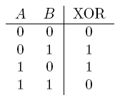
XOR Review
XOR = Exclusive OR
On computer, all information is stored as bits.
Encrypting bits == Encrypting message
Important Property:
A ⊕ B ⊕ A = B
Think of the first XOR as encrypting, second XOR as decrypting
Example: D = 68, Z = 90
68 ⊕ 90 = 1000100 ⊕ 1011010 = 0011110 = 30
30 ⊕ 68 = 0011110 ⊕ 1000100 = 1011010 = 68
Notes:
All probably did truth tables in Geometry with T’s and F’s.
Do Ex. First – 68 = plaintext, 90 = key, 30 = ciphertext

Slide 7
One Time pad
“Perfect cryptography” – cannot be cracked if implemented correctly
How does it work?
1) Come up with a key that is at least as long as the message/data.
2) Encryption: Ciphertext = plaintext ⊕ key
3) Decryption: Plaintext = ciphertext ⊕ key
Provably Perfectly Secure; cannot be cracked - ever.

Slide 8
Thanks for coming
Cryptography Solved! OTP is perfect.
Next meeting same place, same time.
Keep eye out for upcoming CTF competitions.
Join our mailing lists if you haven’t already done so

Slide 9
Important problems with the otp
1) Key must be at LEAST as long as message to be encrypted
2) Key MUST be truly random – if you can guess the key, it’s a bad key.
3) Probably most important:
Key must be used only once. After you encrypt one message with the key, never reuse that key.
Notes:
Restrictions with key re-use:
Meet up, exchange hard disk full of meaningless data for key.
What do you do after the key runs out? Reuse?
How do you implement this in the real world? Can’t just “meet up”, defeats the purpose.

Slide 10
Important considerations
3) Key must be used only once. After you encrypt one message with the key, never reuse that key.
Why?
Let’s say you have:
C1 = M1 ⊕ K
C2 = M2 ⊕ K
Then:
C1 ⊕ C2 = M1 ⊕ K ⊕ M2 ⊕ K = M1 ⊕ M2 ⊕ 0 = M1 ⊕ M2
What can you do with this?

Slide 11
OTP: Key Reuse attack
With M1 ⊕ M2, you can perform frequency analyses on certain bit patterns to deduce characters of each message.
Crib Drag: - Guess words/characters, continue.
M1 = HELLOWORLD
M2 = TODAYTHURS
M1 ⊕ M2 ⊕ TODAY111111… = HELLO010101
Why? Because M2 ⊕ M2 = 0000000, and 000000 ⊕ M1 = M1
Continuing:
HELLOWORLD ⊕ (M1 ⊕ M2) = TODAYTHURS
XOR is commutative and associative!
Notes:
Crib drag – Guess words in the

Slide 12
Practical issues with otp
Key has to be very long – at least as long as message – and must be truly random (as opposed to pseudorandom)
Key can only be used once; once it’s used it has to be thrown away.
Sharing the key securely can be a pain
Notes:
Recap

Slide 13
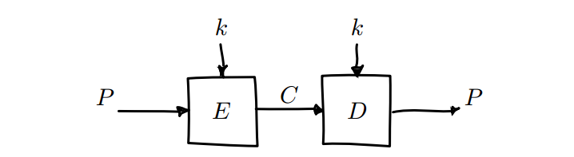
Block ciphers
Symmetric Encryption
Take a block of bits, encrypt it using key. Take a ciphertext block, decrypt it using the key.
Advantage – key doesn’t have to be as long as the message, just as long as a block.
Have Modes of Operation
Notes:
Symmetric – Didn’t solve problem of sharing keys
See if solve large key problem.

Slide 14
ECB Mode
ECB – Electronic Codebook Mode. Take a block of plaintext, encrypt, repeat. Insecure.
Notes:
ECB problem: identical plaintexts encrypt to identical ciphertexts.
Illustrate problem visually

Slide 15
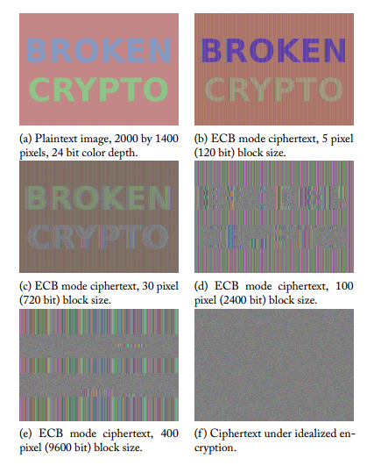

Slide 16
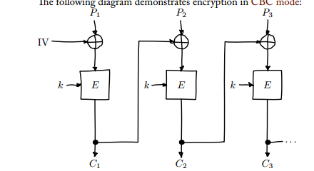
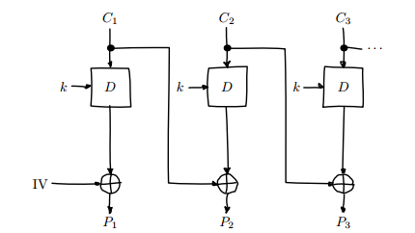
CBC Mode
Cipher Block Chaining – Use output of one encryption as input for the next.
Ensures each block will have different output, even if each block has same plaintext.
ENCRYPTION DECRYPTION
Notes:
IV = Initialization Vector. Random but doesn’t have to be secret.
If IV is predictable – Eve can make a guess about Alice’s data, XOR with own predicted IV, XOR with Alice’s known IV, set this to plaintext.
Then the server will encrypt w/ IV(EVE) XOR GUESS XOR IV(EVE) XOR IV(ALICE) = GUESS XOR IV(ALICE) -> if the guess is correct, our ciphertext is identical to Alice’s and we know her data.
Don’t use key as IV either. Intercepting will allow Eve to figure out the key by modifying some ciphertext.

Slide 17
DES – Deprecated encryption system(ok this is not the actual name)
Data Encryption Standard – 1977
56 bit key size (64 really, but 8 are to check parity and are discarded immediately)
Some attacks known due to small key size
3DES
“DES didn’t work, so let’s just do it 3 times over!”
C = E(k1, D(k2, E(k3, p)))
Expands the key space (168 bits -> 112 effectively)
Several Known attacks, algorithmic reduction of key space to 80 bits.
Deprecated
A lot slower than AES anyway
Notes:
Mentioned before; IBM homegrown crypto
Block cipher with key of 64 bits.
Attacks -> Why not just increase key size?
DES built such that it needs very specific key sizes (computation done using matrices, specific shape, etc)

Slide 18
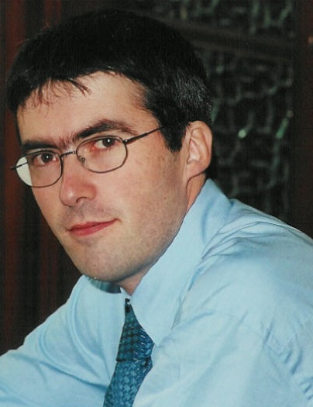
AES - another encryption system
Advanced Encryption Standard
Replaced DES
AES is by now the most important symmetric algorithm in the world.
Came about as a result of competition 1997.
Rijndael – Belgium cryptographers
NSA allows AES for up to TOP SECRET 192 bit key
Very secure, only known attack is a related-key attack on 192 and 256 bit versions which exploits AES’ key schedule. -> Solved by not allowing related keys, force key choice to be as random as possible.
Notes:
History: DES broken, need new standard for crypto.
NIST puts out competition for next best system.
Big name Cryptographers competed (like Ron Rivest [RSA])
Rijndael = Rijmen + Damen
NSA = Validation for algorithm’s worth
Only known attack: Related keys. Nbd anyway, force keys to be random.

Slide 19
HOW AES Works from a high level

Slide 20
Problems w/ Block ciphers
Messages must be a very limited length – block length of block cipher
Still have the issue of how to agree on the key

Slide 21
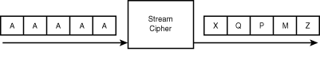
Tackling the Fixed size – Stream ciphers
Symmetric-key encryption algorithms that encrypts a stream of bytes
Stream as long as we like.
Encryption – one bit or byte at a time
Notes:
Very fast

Slide 22
Stream ciphers aren’t as big
One of earliest stream ciphers was RC4.
Extremely fast, especially compared to DES.
Extremely broken.
Left cryptographers a bad impression of native stream ciphers.

Slide 23
how to solve fixed block size problem
Could just take a block cipher algorithm, add padding to plaintext until fits size of block.
May be susceptible to padding attacks
Notes:
Seems to be a problem inherent with block ciphers in general.

Slide 24

Block cipher uses
OK, assuming we have a block cipher, what can we use it to do?
Ex. AES
DiskCryptor
NTFS – Encrypting File Systems
LastPass
DataLocker
GTA IV – encrypt game assets to deter hacking in multiplayer.

Slide 25
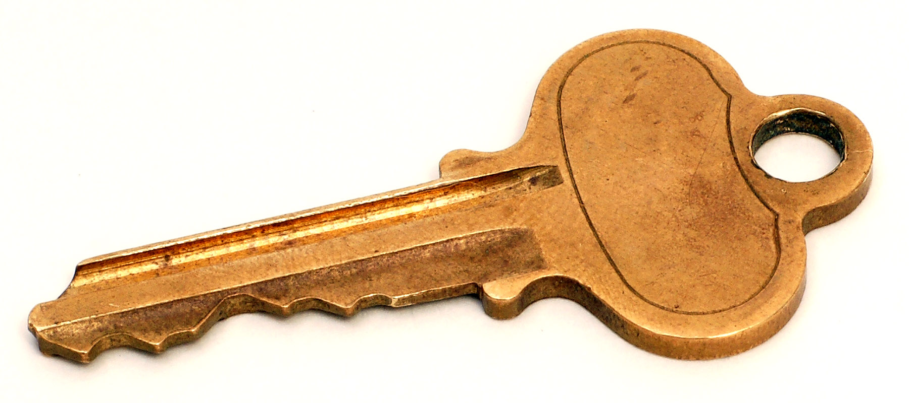
Finally – how do we exchange keys
The final problem we set out to tackle – secure key exchange
2 possible solutions that I’ll glance you through:
Diffie-Hellman Key Exchange
RSA

Slide 26
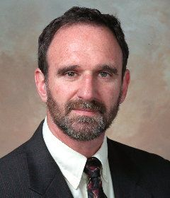
Diffie hellman
Use colors to explain process
Colors: Easy to mix, hard to separate
Actually done using math but conceptually this is good enough

Slide 27
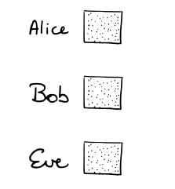
1) Choose a base color
Notes:
Alice and Bob agree on a Base Color.
This is communicated over the channel; doesn’t matter if Eve knows.

Slide 28
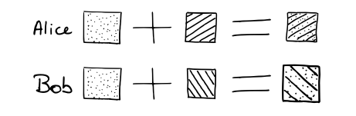
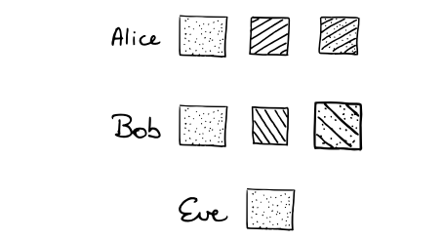
2) Mix base with own private random color
Notes:
At the end of this step, Alice and Bob know their secret colors, but Eve does not.

Slide 29
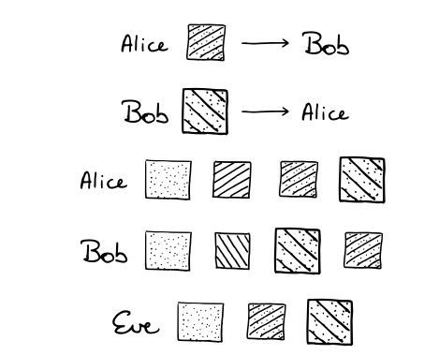
3) Communicate mixed colors
Notes:
Alice and Bob send the mixed colors to each other.
Eve gets these too, but she doesn’t know the secret colors that were mixed into them.

Slide 30
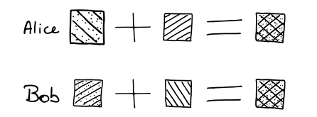
4) Mix own secret color with other’s mixed color
Notes:
Now, both Alice and Bob have the same exact color. And this is a shared secret.
Eve can’t perform this computation since she doesn’t have the secret colors to make Alice’s / Bob’s mixed colors.

Slide 31
Another approach – Public key cryptography and rsa
Problem with symmetric cryptography: I have a key and I want you to talk to me securely. How do I give you my key?
Proposed solution: Asymmetric cryptography

Slide 32


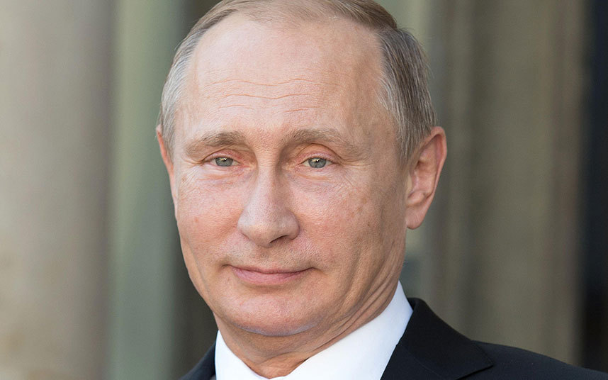
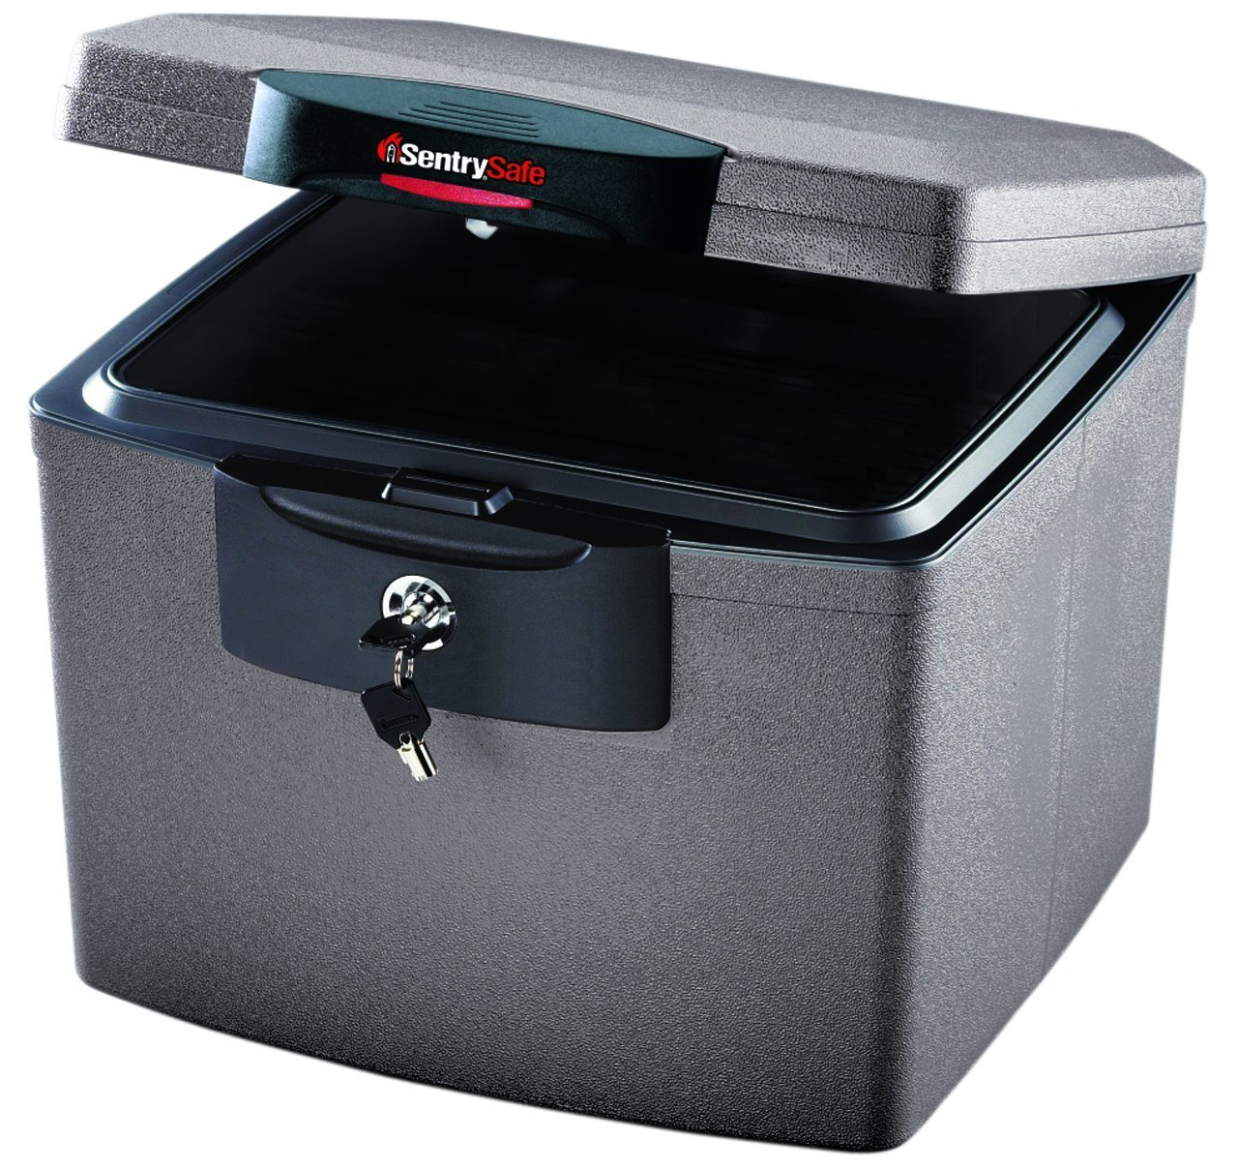
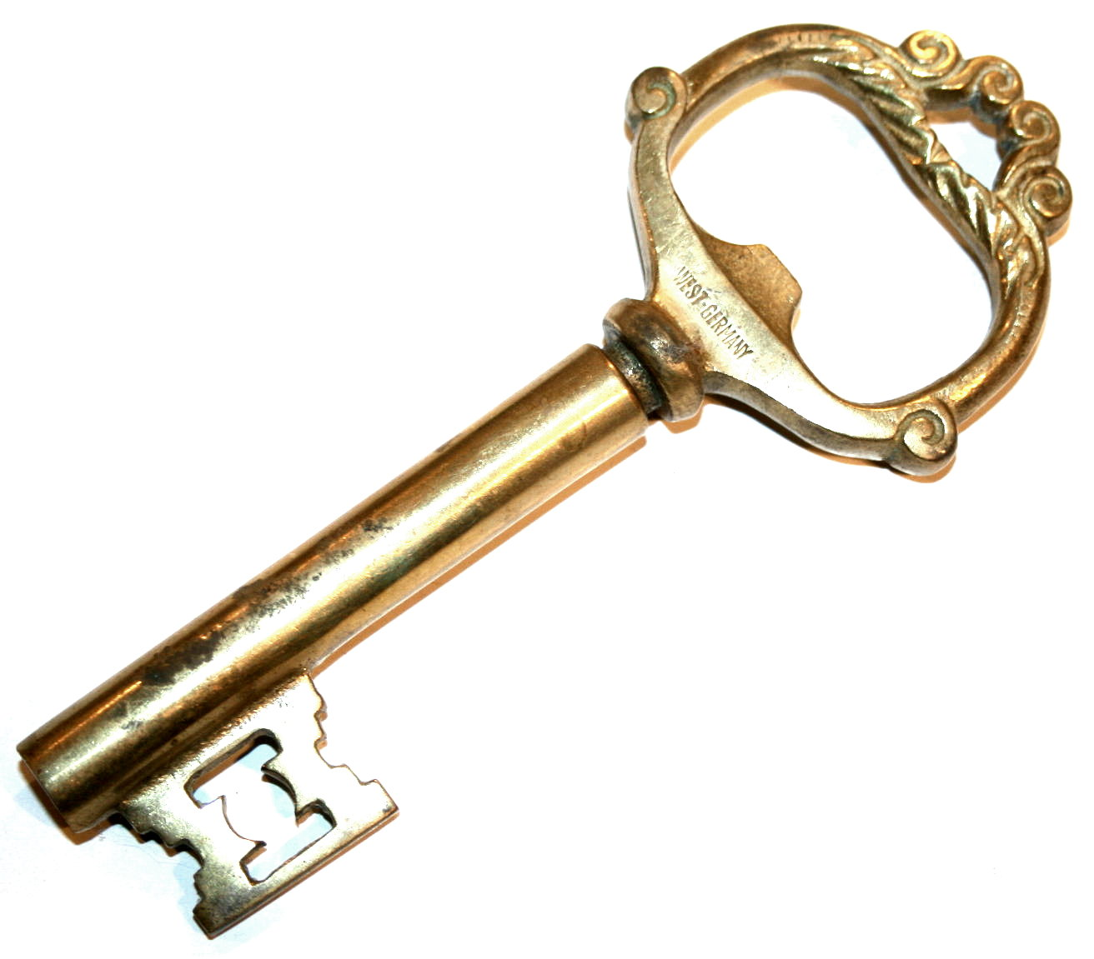
Another approach – Public key cryptography and rsa
Putin teach me how u lift bro
123#&!ABCDEFGOAT
Putin teach me how u lift bro
Notes:
Let’s say you have two conspiring dictators that want to talk to each other secretly.
Has everyone seen the pictures of Putin on a horse?

Slide 33
This time for real
Recap:
Crypto is a lot of math
Never make your own crypto
Secret crypto <<< Publicly reviewed crypto
Most of the time, attacks are on implementation and not math. But helps to know math to attack the implementation.
Thanks for coming!
Most of the information that I went over today, I found here: https://www.crypto101.io/
They have a really amazing Ebook that was really easy to follow and had great examples.
Dan Boneh’s Cryptography Course
Matasano Cryptopals

Slide 34
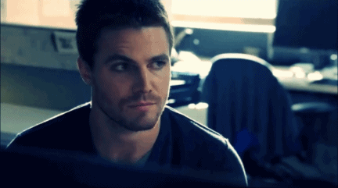
Any questions

